Slide 1

B. Tech. Mini Project (6th Semester) PRESENTATION
of the mini project entitled
“Semi Automated Model for calculation of g using pendulum based on IR-Sensors”
for the End Semester Examination in Electronics and Communication Engineering (ECE)
by
Saransh Kumar(17-14-118)
Prashant Jha(17-14-119)
Pradeep Singh(17-14-120)
Under the supervision of
Dr. Chandrajit Choudhury
Assistant Professor
Department of Electronics and Communication Engineering
National Institute of Technology Silchar, Assam, India

Slide 2
Overview
Project Objective
Project Requirements
Physical Components
Softwares
Schematic Diagram
Block Diagram
Flow Chart
Conclusions
References

Slide 3
Project Objective
To perform the experiment “calculation of gravitational acceleration constant(g) using a pendulum” with the help of Semi automatic Infrared(IR)-based motion sensors based on Arduino Uno.

Slide 4
Project Requirements
Physical Components
Measuring Instruments
Simple Pendulum
Vernier Caliper
Digilent IR Proximity Sensor
Arduino Uno
Male/Female Jumper Wires
Software
Arduino IDE

Slide 5
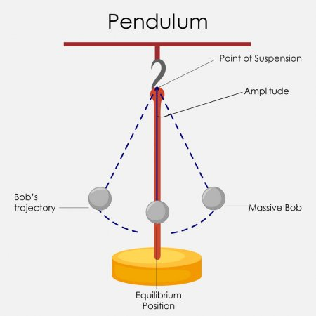
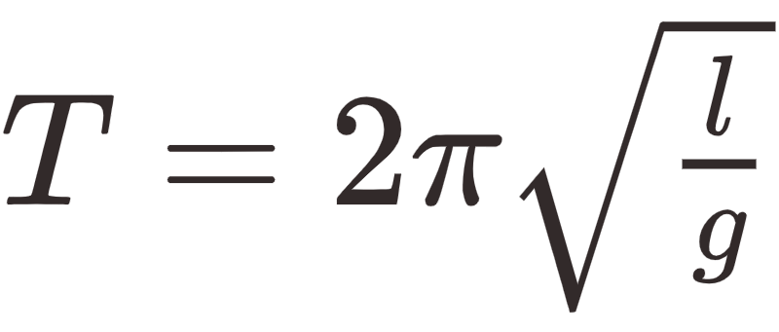
Simple Pendulum
A point mass suspended by a massless string which swings back and forth about the suspension point.
A restoring force acts up due to gravity whenever the pendulum is moved away from its equilibrium position, which in fact is responsible for the simple harmonic motion performed by the bob.
T Time to complete one oscillation
.

Slide 6
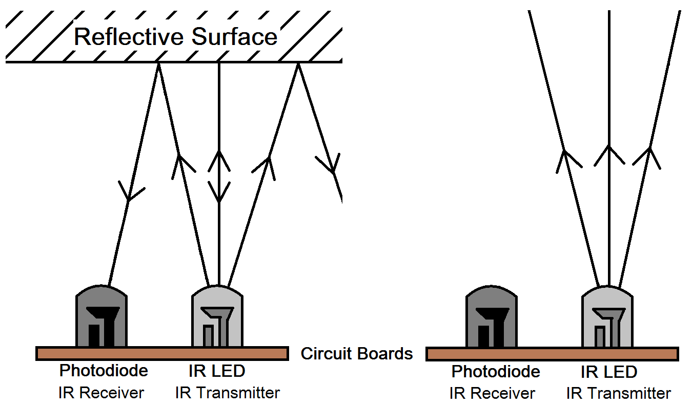
IR Sensor
It is an electronic device that measures and detects infrared radiation.
For object detection we use Active Infrared sensors.
Active Infrared sensors consists a LED(IR Transmitter) and a photodiode(IR Receiver), together they are called Photo-Coupler or Opto -Coupler.
IR transmitter emits radiation, of which some bounces back to the IR receiver when it reaches the object.

Slide 7
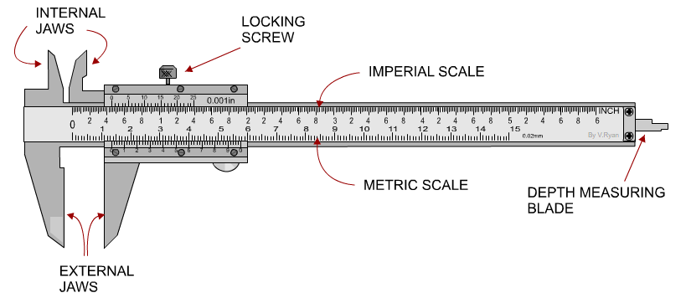
Vernier Caliper
The vernier caliper is an extremely precise measuring instrument.
It can measure internal as well as external distances with great accuracy.
It consist a small movable scale(called vernier scale) mounted over the fixed main scale to measure the fractional parts of the main scale division.
n divisions of vernier scale corresponds to n-1 divisions of the main scale.

Slide 8
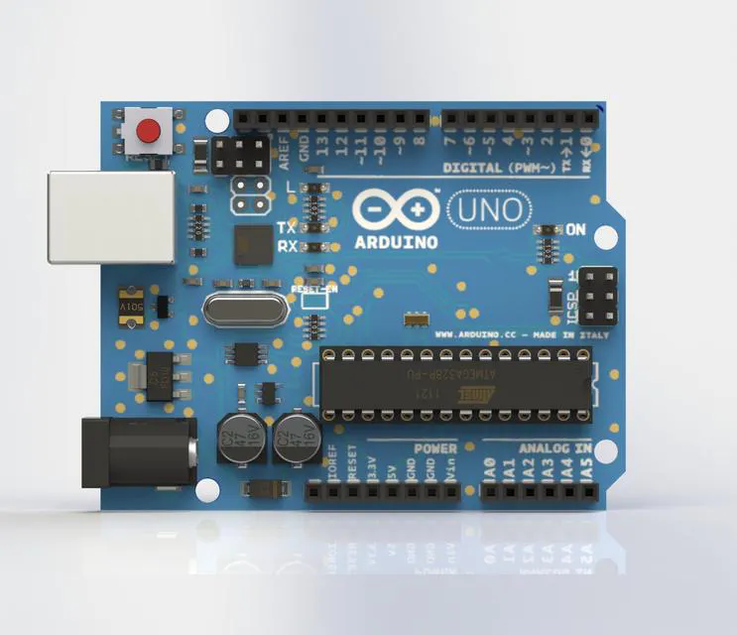
Arduino Uno
Arduino Uno is an open-source microcontroller board which is based on the Microchip ATmega328P microcontroller.
It can interface with various expansion boards and other circuits by using the input/output(I/O) pins provided in the board.
The board consists 14 Digital pins, 6 Analog pins, and programmable with Arduino IDE.
A USB cable or an external 9 volt battery can be used to power the board.

Slide 9

Arduino IDE
It is a cross-platform application.
Written in C and C++.
It is used write and upload programs to Arduino compatible boards.
It may also be extended to other vendor developement boards with the help of 3rd party cores.
The value of g was serially monitored and plotted using this software.

Slide 10
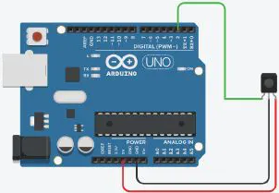
Schematic Diagram

Slide 11
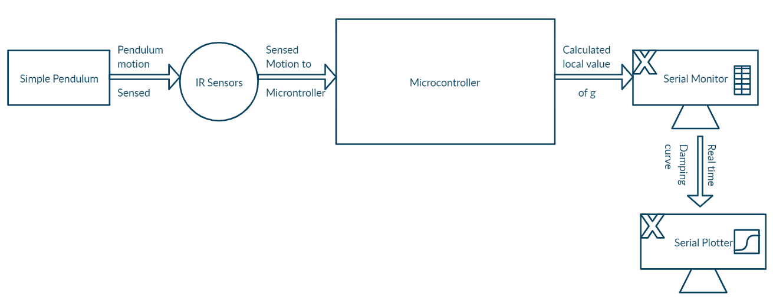
Block Diagram

Slide 12
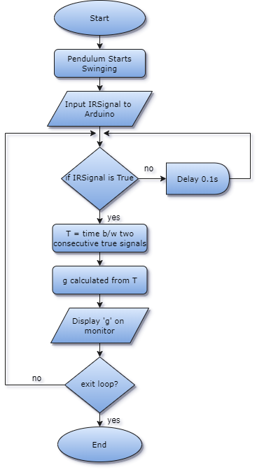
Flow Chart

Slide 13
Procedure
First, the instrument is set up with the IR sensor being placed at the equilibrium position.
The IR sensor is connected with the right pins in the Arduino board.
The code written in the

Slide 14
Procedure
Construct a frame
1. CONSTRUCT A FRAME
A good and strong frame is constructed using wood or other suitable material to hold the pendulum firm, which reduces shake and thus reduces errors.
2. SIMPLE PENDULUM
A simple pendulum of suitable length (~15 cm) is made using a bob and a massless inextensible string.
3. SENSOR
Place the IR sensor at the suitable distance below or beside the bob of simple pendulum so as to get the maximum accuracy in measurement. The accuracy is verified for various baud rates of microcontroller.
And this is how the sensor works, in an oscillation whenever the bob covers the IR sensor it will return a value 0 to the microcontroller otherwise it will return 1 to the microcontroller.
4. ARDUINO UNO
Arduino Uno is the brain of this project, it reads the value from the IR proximity sensor and the measure the time between two consecutive 0 values, is the half of time period. For each half oscillation it calculates the value of ‘g’ and by adding the consecutive ‘g’ values of two half oscillations the mean value of ‘g’ for one oscillation is found. As the oscillations proceed the amplitude of oscillations goes on decreasing. By the data collected using IR sensor a real time damping curve is drawn.
5. CODE
Arduino uses C/C++ code with its own slight modifications. Code has two parts, the major part is to analyze sensor and all determines whether the bob is in the mean position or not. digitalRead() function is used to read the sensor data. If the value is 0 the bob is in the mean position and if 1 it is not. The micros()function is used to measure the time period.
Using the Serial.println()function the value of ‘g’ is printed and a real time damping curve is drawn in the serial plotter.

Slide 15
Conclusion
The Semi-automated Model based on proximity IR sensor with Arduino Uno, leads to easier and fast way to perform the physics lab experiment “calculating g using a pendulum”.
With the added factor of less human interaction, the model has lesser number of human errors as compare to the manual approach.

Slide 16
References
Arduino Official Website - www.arduino.cc
Google Search

